Slide 1
Asamawu Ibrahim [Asmaan MicroFinance]
Web Tech Summer 2024 Final Exams

Slide 2
Asmawu Ibrahim is developing a microfinance platform to help users, clients and potential customers to easily request for loans , and have the loans immediately approved at an affordable interest rate. The microfinance platform will make it easy for the clients to keep track of the loan status and to easily connect to the microfinance institution, in terms of expressing concerns or making repayments.

Slide 3







Project Title
ddd
The loan will be approved easily at an affordable interest rate. This will solve the long and tedious process of requesting loan from any other financial institution
We estimate that most of our customers will come from the low-income bracket. We are willing to help them financially to ensure that they excel in their field of work.
Customers can apply for loan easily and receive approval quickly
By helping our customers, who are usually from the low-income bracket, we help make the world a better place. We can help stimulate Ghana’s economy

Slide 4
User / Customer
Asmaan Microfinance is here for everyone. The target customers are mostly people who require some loan (not too big an amount) and will pay back with profoundly affordable interests. To facilitate effective communication with us client will find the Asmaan microfinance web app very helpful.
For the roles, we have the admin and super admin who have access to the entire system; both the front-end and backend, but not access to each client page. This page is unique for each client and must be left to their discretion. However, the admins have their own view of the status of each client. The super admin has access to all pages on the admin side. The admin has access to some pages but is restricted in other pages like the moan management and transaction management. Only the super admin can exercise CRUD at this pages. The admin can only view the changes that happens at this page but can never makes changes.
The users have been broken down into, standard users, loan applicants and clients. Anyone who signs up or register to our web app is a standard user. Anyone applying for a loan becomes a loan applicant; when the loan is approved, you become a client. The pages you can see depends on your user role.

Slide 5
Main Functions of the Website
Easy loan application
Quick loan approval
The client can see their loan status in their loan page
Clients can make repayments via MOMO/Bank-Account.

Slide 6
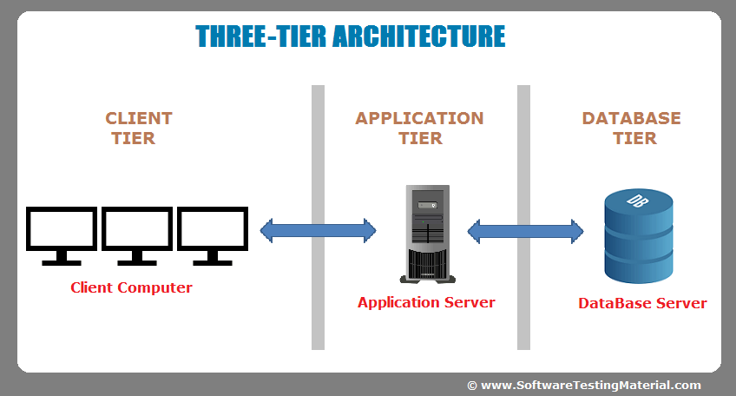
Architecture
Client or Presentation Tier
This is the user interface layer where users interact with the application. It displays information and collects user input.
Application Tier
This is the logic tier, this layer processes user input and performs operations based on business logic. It communicates with both the presentation and database tiers.
Database Tier
This tier is responsible for storing and managing application data. It interacts with the application tier to retrieve and manipulate data.
Programming Languages
HTML: For structuring web pages.
CSS: For styling the user interface.
JavaScript: For adding interactivity and writing regex validations.
PHP: used for server-side scripting.
Technologies and Frameworks
Front-end Frameworks
UI Libraries:
1. Bootstrap
2. Tailwind CSS

